Slide 1

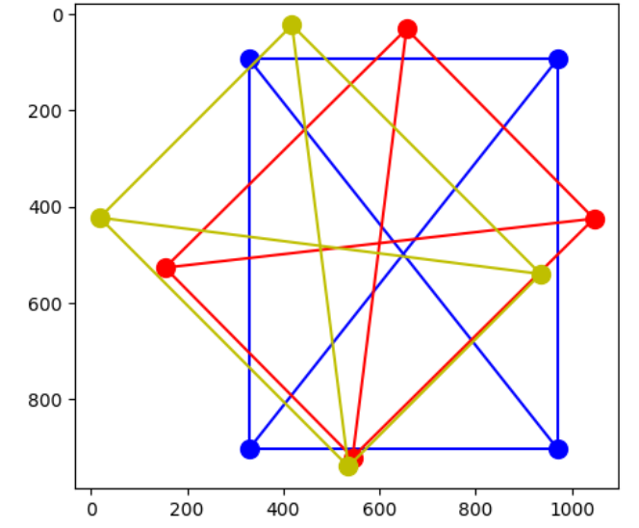

Kabsch-Umeyama Algorithm for Page Alignment
Ean J Maloney

Slide 2


Goal
ABC123
Given a photograph of a document, transform the image to align the document at right angles with the image boundaries without scaling (stretching) the document.
ABC123

Slide 3
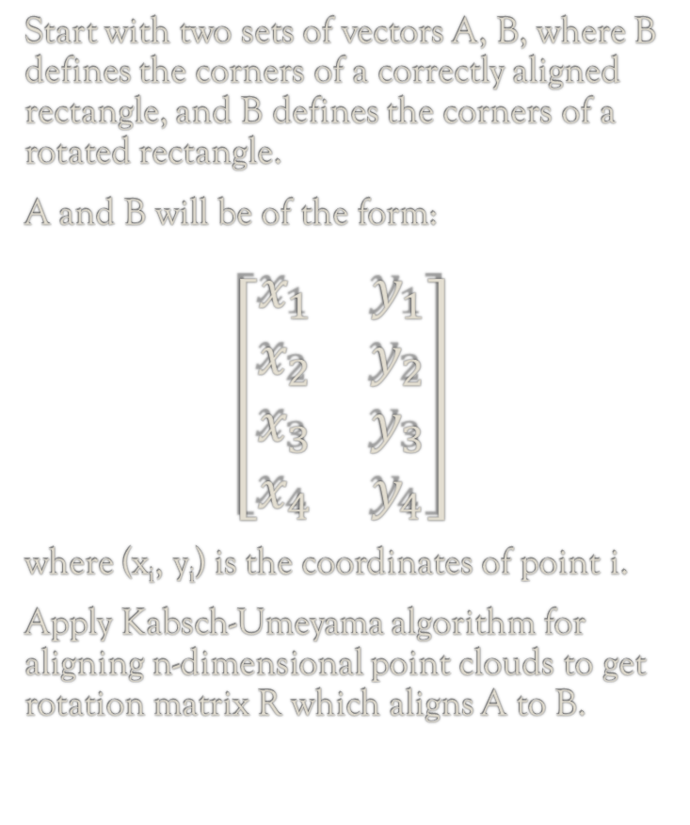
Theoretical Approach
Kabsch-Umeyama Algorithm^{1,2,3}
Compute 2 × 2 matrix:
H = A^{T}B.
Compute SVD of H, i.e., identify 2 × 2 matrices U, S, V, so that H = USV^{T}.
Let Ŝ = I if det(V) * det(U) ≥ 0, else Ŝ = diag(1, -1).
Return 2 × 2 rotation matrix
R = UŜV^{T}.
Start with two sets of vectors A, B, where B defines the corners of a correctly aligned rectangle, and B defines the corners of a rotated rectangle.
A and B will be of the form:
$$\left[\begin{matrix}x_{1} & y_{1} \\ x_{2} & y_{2} \\ x_{3} & y_{3} \\ x_{4} & y_{4}\end{matrix}\right]$$
where (x_{i}, y_{i}) is the coordinates of point i.
Apply Kabsch-Umeyama algorithm for aligning n-dimensional point clouds to get rotation matrix R which aligns A to B.
Notes:
https://math.nist.gov/~JBernal/kujustf.pdf
Umeyama, Shinji (1991). "Least-Squares Estimation of Transformation Parameters Between Two Point Patterns". IEEE Trans. Pattern Anal. Mach. Intell. 13 (4): 376–380. doi:10.1109/34.88573
https://en.wikipedia.org/wiki/Kabsch_algorithm

Slide 4
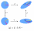
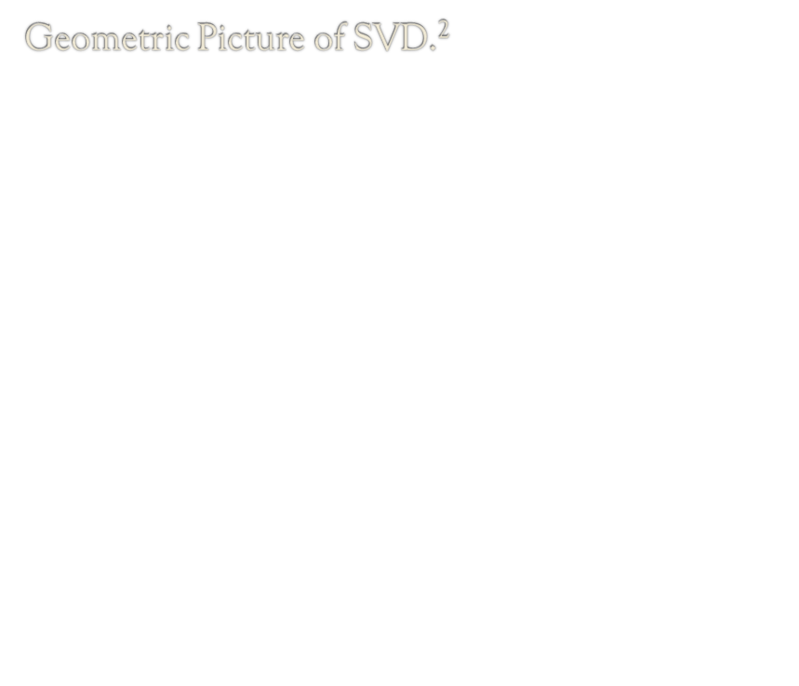
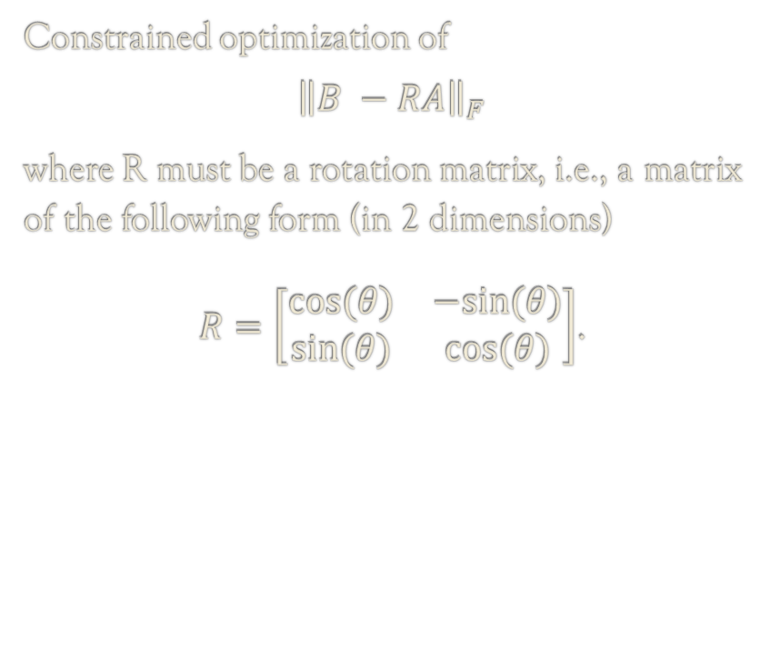
Mathematical View of Kabsch-Umeyama
Constrained optimization of
$${\left\|B −RA\right\|}_{F}$$
where R must be a rotation matrix, i.e., a matrix of the following form (in 2 dimensions)
$R=\left[\begin{matrix}cos⁡(θ) & −sin⁡(θ) \\ sin⁡(θ) & cos⁡(θ)\end{matrix}\right]$.
Geometric Picture of SVD.²
Notes:
2. Image modified from https://en.wikipedia.org/wiki/Singular_value_decomposition#/media/File:Singular-Value-Decomposition.svg.

Slide 5
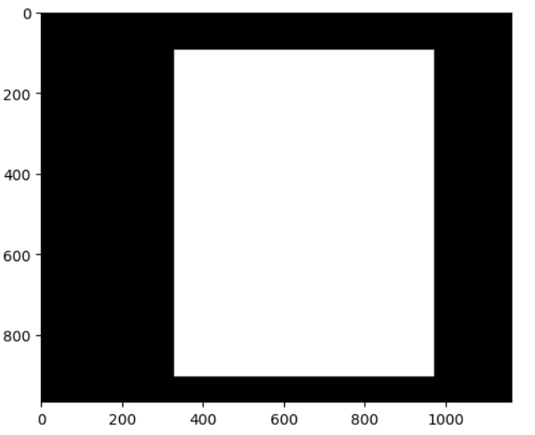
Practical Steps for Application
1. Convert image to binary colors.
2. Apply algorithm for finding corners of
page.
3. Stack coordinates of corners into a
4 x 2 matrix.
4. Center A and B around the origin by subtracting the mean from each column.
5. Multiply A by R so that AR ≈ B.

Slide 6
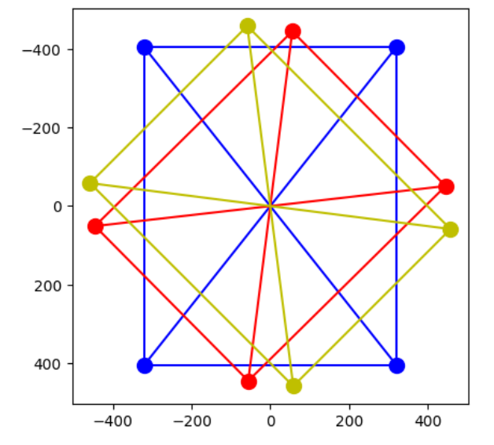
Examples
Take 3 sets of corners P, Q, L and align them to the origin:
P – blue
Q – red
L – yellow

Slide 7
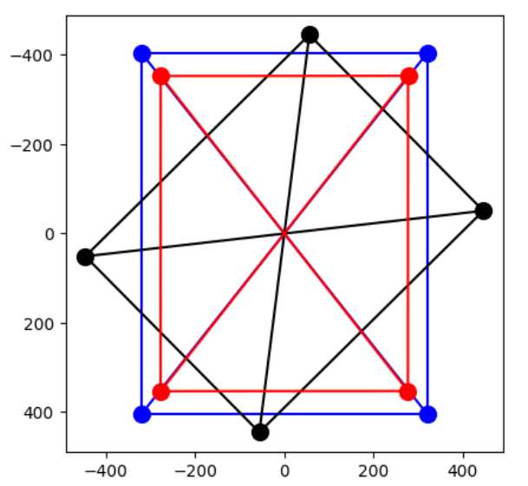
Example 1: Align Q to P
P = [[-320.5, -404.5],
[ 320.5, -404.5],
[-320.5, 404.5],
[ 320.5, 404.5]]
Q = [[ 56., -445.],
[ 446., -51.],
[-446., 51.],
[ -56., 445.]]
R = [[ 0.703, -0.711],
[0.711, 0.703]]
QR = [[-277.0, -352.6], [ 277.3, -353.0],
[-277.3, 353.0],
[ 277.0, 352.6]]

Slide 8
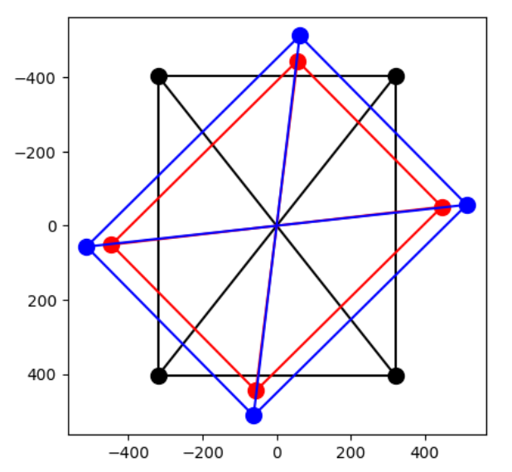
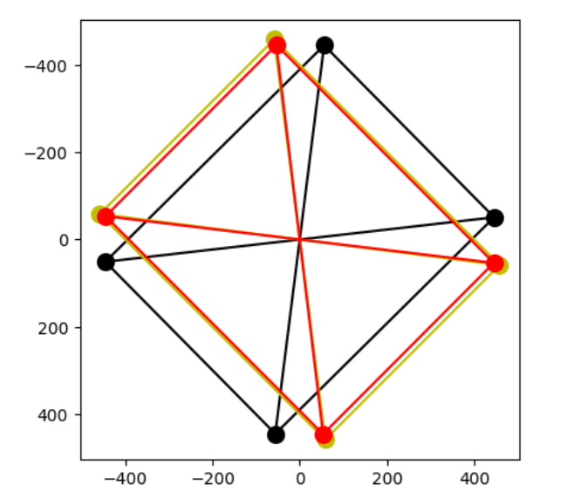
Example 2, 3: Align P to Q, Q to L
R = [[ 0.703, 0.711],
[-0.711, 0.703]]
R = [[-0.005, -0.999],
[ 0.999, -0.005]]

Slide 9
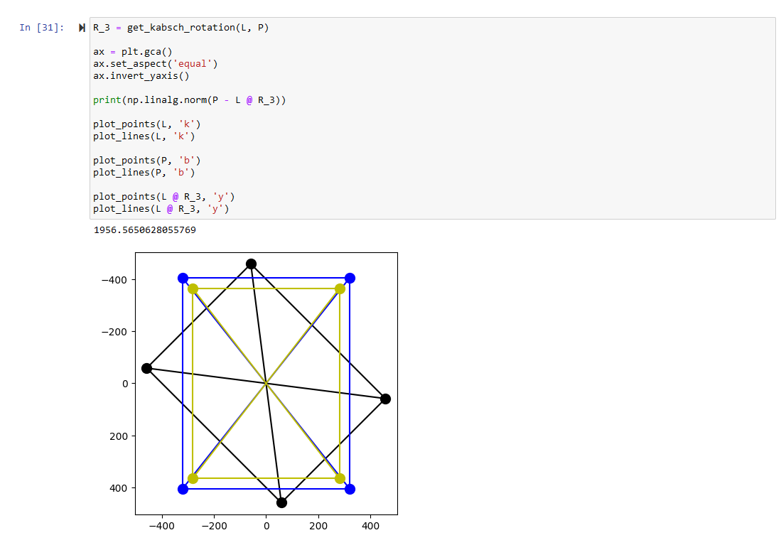
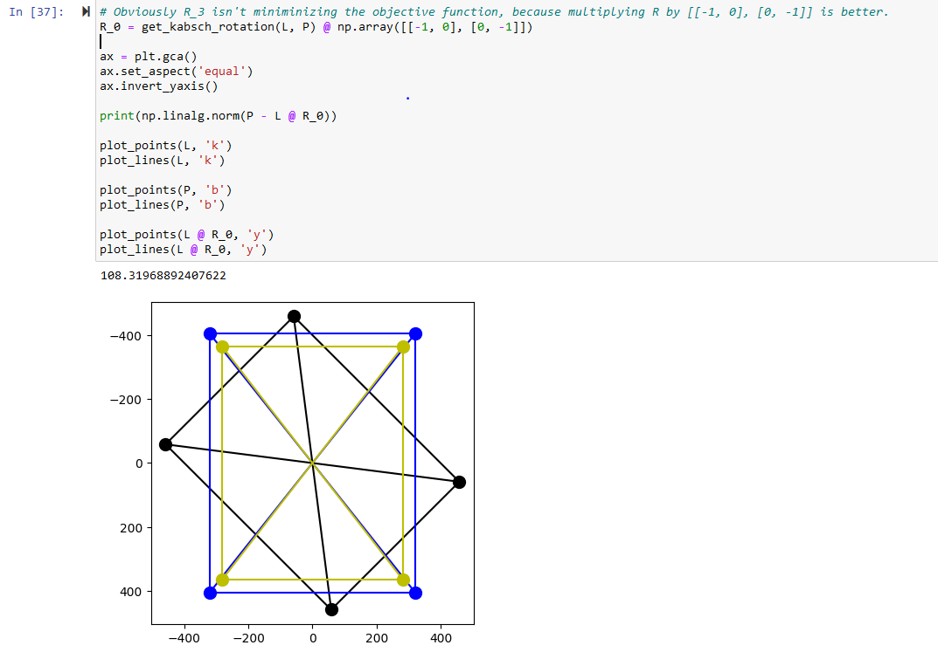
Unsolved Problems
Sometimes fails to match points correctly, leading to unexpected orientation.

